Slide 1


DataForce

Slide 2
TABLE OF CONTENTS
01
03
02
04
Our Team
Work progress
About the Idea
Programs we used

Slide 3

01
OUR TEAM

Slide 4
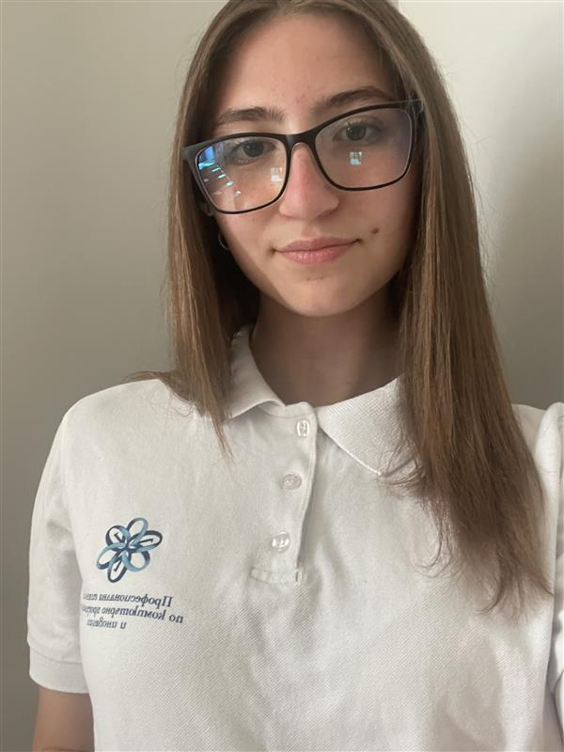
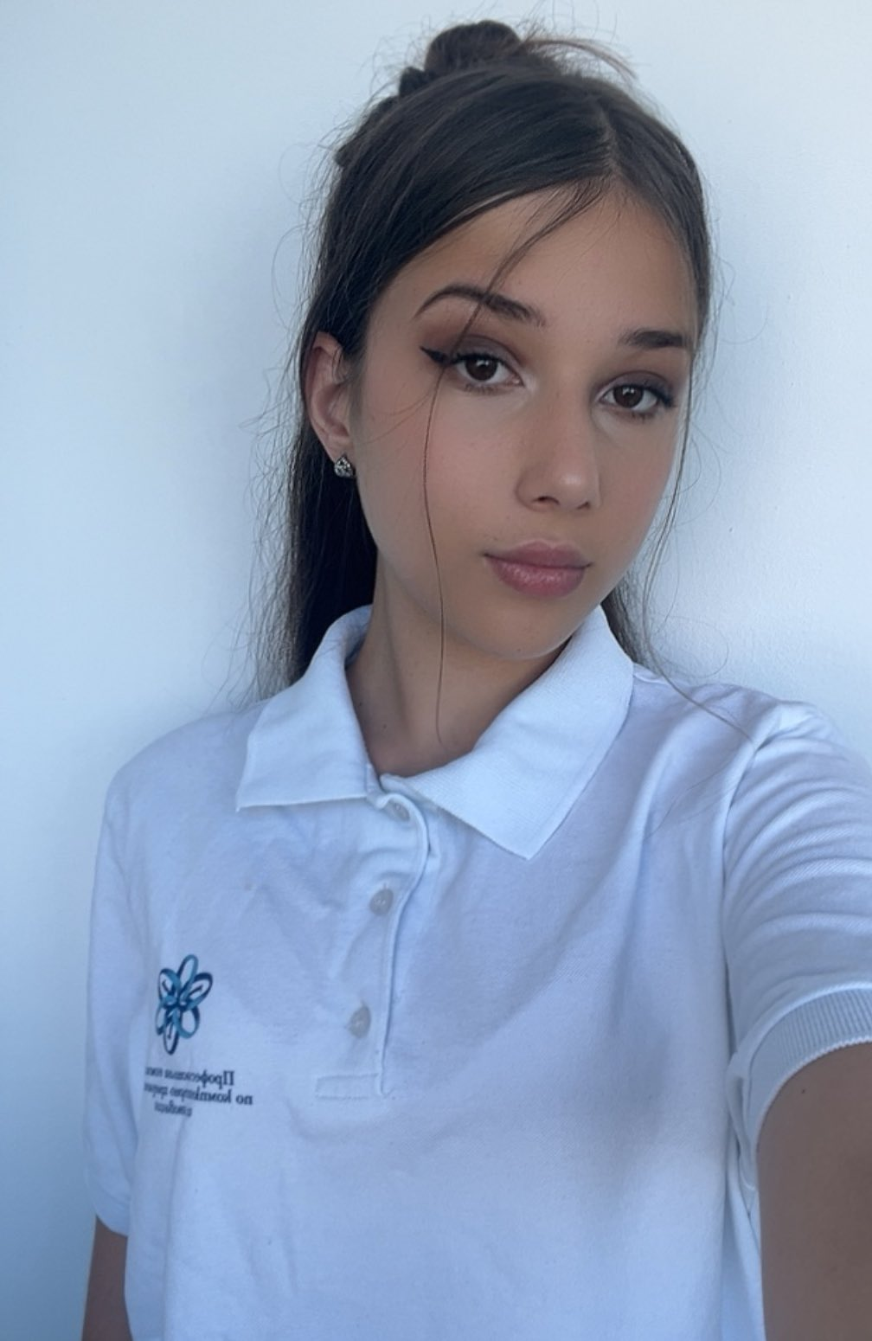

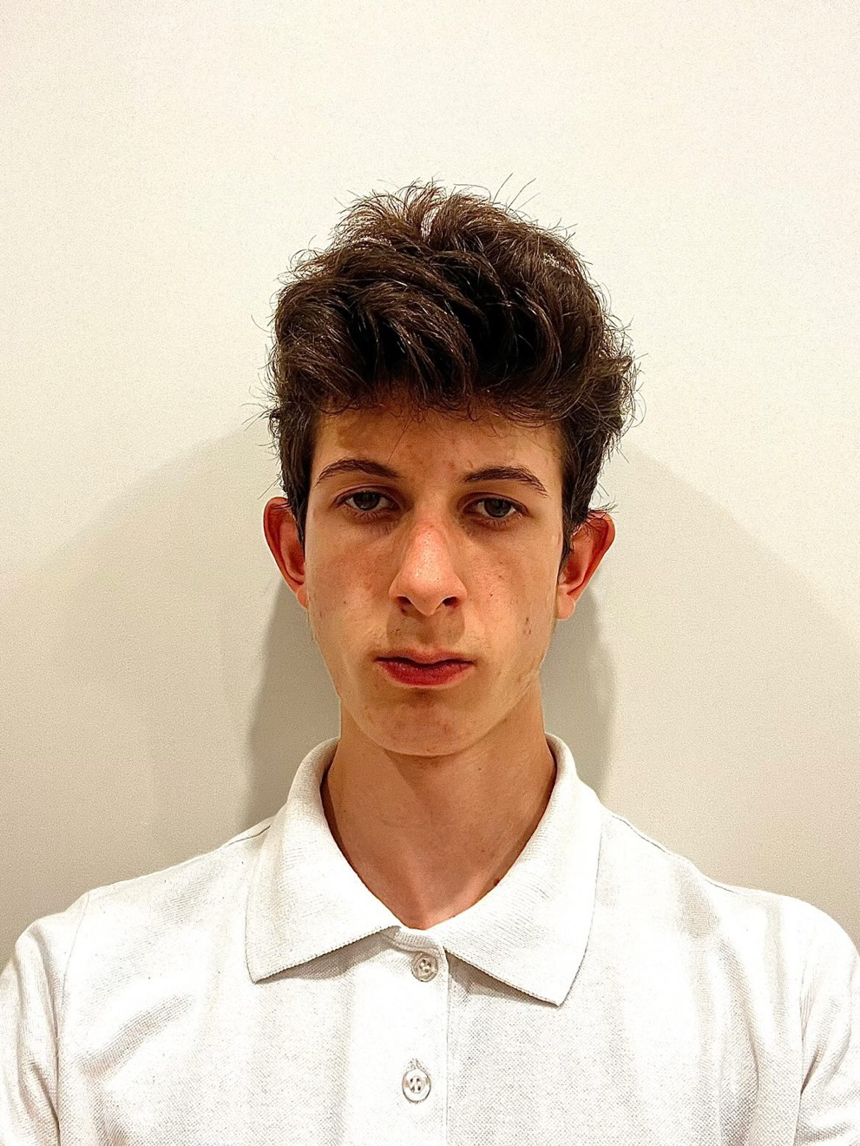
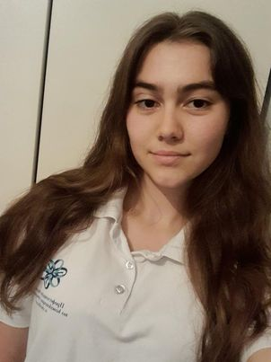
Back-End Dev.
Designer
Aleksey Atanasov
Desislava Peeva
Valeriya Damyanova
Valeriya Vulchanova
Scrum Trainer
Front-End Dev.

Slide 5
02
ABOUT THE IDEA

Slide 6

The idea of ​​our e-school is to provide students with interactive worksheets, PDF files with materials published by teachers, and an overview of GPA and grades. Teachers will have the ability to add and delete grades and add materials. For now, this idea is only for 9th grade, but with more knowledge in the future we will be able to develop it to be suitable for all grades.

Slide 7
03
WORK PROGRESS

Slide 8
Period | Monday | Tuesday | Wednesday | Thursday | Friday | Saturday | Sunday
24.02-02.03
03.03-09.03
10.03-16.03
17.03-23.03

Slide 9
04
PROGRAMS WE USED

Slide 10










Slide 11
Let's see our e-school program

